Slide 1
Computer Organization Principles
School of Software, Dalian University of Technology
Chi Lin (林驰)
chilin@mail.dlut.edu.cn

Slide 2
Chapter Five: Processor Architecture
Processor Organization (Architecture)
Processor Implementations (Realizations)
Instruction Pipeline (Optimizations)

Slide 3
Processor Implementations
Instruction Cycle
Organizing Processing into Stages
Sequential Implementations
Sequence Hardware Structure
Timing

Slide 4
Instruction Cycles
An instruction cycle
Fetch
Interrupt
Execute
Indirect
Not easy to give a standard description scheme

Slide 5
Detailed analysis
A diagram can be used for denoting all the instructions as follows.
What is it used for ?
The answer is divide the instruction execution into stages, and optimize the procedure.

Slide 6
Organizing Processing into Stages
In general, processing an instruction involves a number of operations. We organize them in a particular sequence of stages, attempting to make all instructions follow a uniform sequence, even though the instructions differ greatly in their actions.
Five Stages
Fetch (取指F)
Decode (译码D)
Execute (执行E)
Visit Memory (访存M)
Write back (写回W)
PC update (更新PC)

Slide 7
Fetch 取指
The fetch stage reads the bytes of an instruction from memory, using the program counter (PC) as the memory address.
Extract the two 4-bit portions of the instruction specifier byte, referred to as icode (the instruction code) and ifun (the instruction function).
Fetch a register specifier byte, giving one or both of the register operand specifiers rA and rB.
Fetch a 4-byte constant word valC.
Compute valP to be the address of the instruction following the current one in sequential order.

Slide 8
Decode 译码
The decode stage reads up to two operands from the register file, giving values valA and/or valB.
Typically, it reads the registers designated by instruction fields rA and rB, but for some instructions it reads register %esp.

Slide 9
Execute 执行
ALU either performs the operation specified by the instruction (according to the value of ifun), computes the effective address of a memory reference, or increments or decrements the stack pointer. We refer to the resulting value as valE. The condition codes are possibly set.
For a jump instruction, the stage tests the condition codes and branch condition (given by ifun) to see whether or not the branch should be taken.

Slide 10
Visit Memory 访存
The memory stage may write data to memory, or it may read data from memory. We refer to the value read as valM.
Operations to memories.

Slide 11
Write Back 写回
The write-back stage writes up to two results to the register file.
Operations to registers

Slide 12
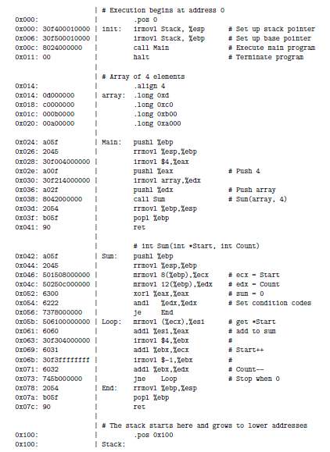
PC update
The PC is set to the address of the next instruction.

Slide 13
Program Counter (PC)
The central processing unit (CPU), or simply processor, is the engine that interprets (or executes) instructions stored in main memory. At its core is a word-sized storage device (or register) called the program counter (PC).
At any point in time, the PC points at (contains the address of) some machine-language instruction in main memory.

Slide 14
Program Counter
From the time that power is applied to the system, until the time that the power is shut off, a processor repeatedly executes the instruction pointed at by the program counter and updates the program counter to point to the next instruction.
A processor appears to operate according to a very simple instruction execution model, defined by its instruction set architecture.

Slide 15
PC behavior in SEQ
In this model, instructions execute in strict sequence, and executing a single instruction involves performing a series of steps.
The processor reads the instruction from memory pointed at by the program counter (PC), interprets the bits in the instruction, performs some simple operation dictated by the instruction, and then updates the PC to point to the next instruction, which may or may not be contiguous in memory to the instruction that was just executed.

Slide 16
PC A example in SEQ

Slide 17
Instruction Details
Pay Attention to the following issues:
PC behavior
Register, memory, ALU
Instruction decoding
Outcomes

Slide 18
Instruction Details Analysis

Slide 19
Y86 ISA to reference

Slide 20
subl %edx, %ebx: An Example

Slide 21
Another example: rmmovl

Slide 22
SEQ Hardware Structure
Fetch
Using the program counter register as an address, the instruction memory reads the bytes of an instruction. The PC incrementer computes valP, the incremented program counter.

Slide 23
SEQ Hardware Structure
Decode
The register file has two read ports, A and B, via which register values valA and valB are read simultaneously.

Slide 24
SEQ Hardware Structure
Execute
Arithmetic & Logical Calculations
The condition code register (CC) holds the three condition-code bits.
When executing a jump instruction, the branch signal Cnd is computed based on the condition codes and the jump type.

Slide 25
SEQ Hardware Structure
Memory
The data memory reads or writes a word of memory when executing a memory instruction. The instruction and data memories access the same memory locations, but for different purposes.

Slide 26
SEQ Hardware Structure
Write back
The register file has two write ports. Port E is used to write values computed by the ALU, while port M is used to write values read from the data memory.

Slide 27
Hardware Structure
A detailed description of SEQ implementations

Slide 28
Homework
Practice Problem 4.11,4.12,4.15,4.16
Review Chapter 4.1 & 4.3

Slide 29
Thank You

